Slide 1

Project Title - Blockchain-Based Land Registry Smart Contract
[Presented by: Aditi Agnihotri ]

Slide 2

PROBLEM STATEMENT
• Traditional land records suffer from corruption, fraud, and inefficiencies.
• Fake documents, illegal transfers, and bureaucratic delays make the system unreliable.
• Middlemen increase transaction costs and reduce transparency.

Slide 3
Blockchain-Based Land Registry Smart Contract
The Blockchain-Based Land Registry Smart Contract aims to revolutionize the traditional land registration process by utilizing blockchain technology to provide a secure, transparent, and tamper-proof system for property ownership. This project introduces an efficient way to register, transfer, and verify land ownership using smart contracts, eliminating many of the issues found in traditional systems, such as fraud, corruption, and inefficiencies.

Slide 4

WHO ARE THE END USERS?
Landowners: A secure, transparent system for managing and
transferring ownership without worrying about fraud or document falsification.
Buyers: Assurance that the land is genuinely available for sale,
with a transparent and easily verifiable history of ownership.
Government & Legal Bodies: Reduced corruption, fraud, and inefficiency in land transactions,
while ensuring that all legal and regulatory processes are adhered to.
Banks & Financial Institutions: Clear verification of land ownership records
for secure lending and financing.

Slide 5

Technology Used
• Solidity – Smart contract programming language.
• Remix IDE – Web-based Ethereum development environment.
• MetaMask – Crypto wallet for contract interaction.
• Hardhat/Truffle – Testing and deploying contracts in VS Code.

Slide 6
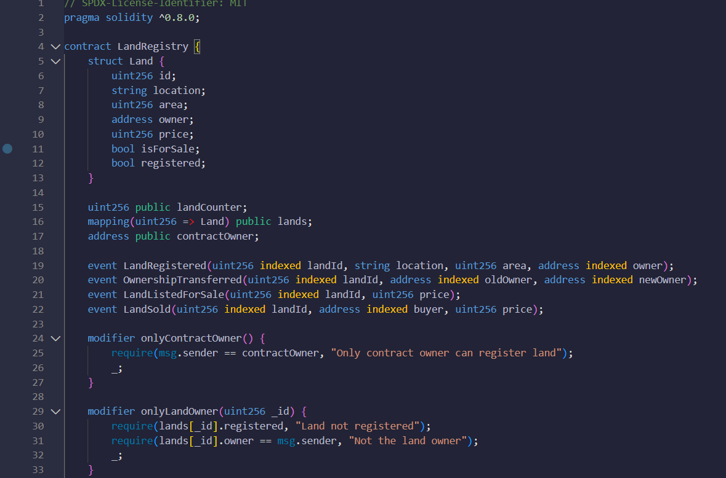
RESULTS
[Add screen shots of your code ]
Demo Link

Slide 7
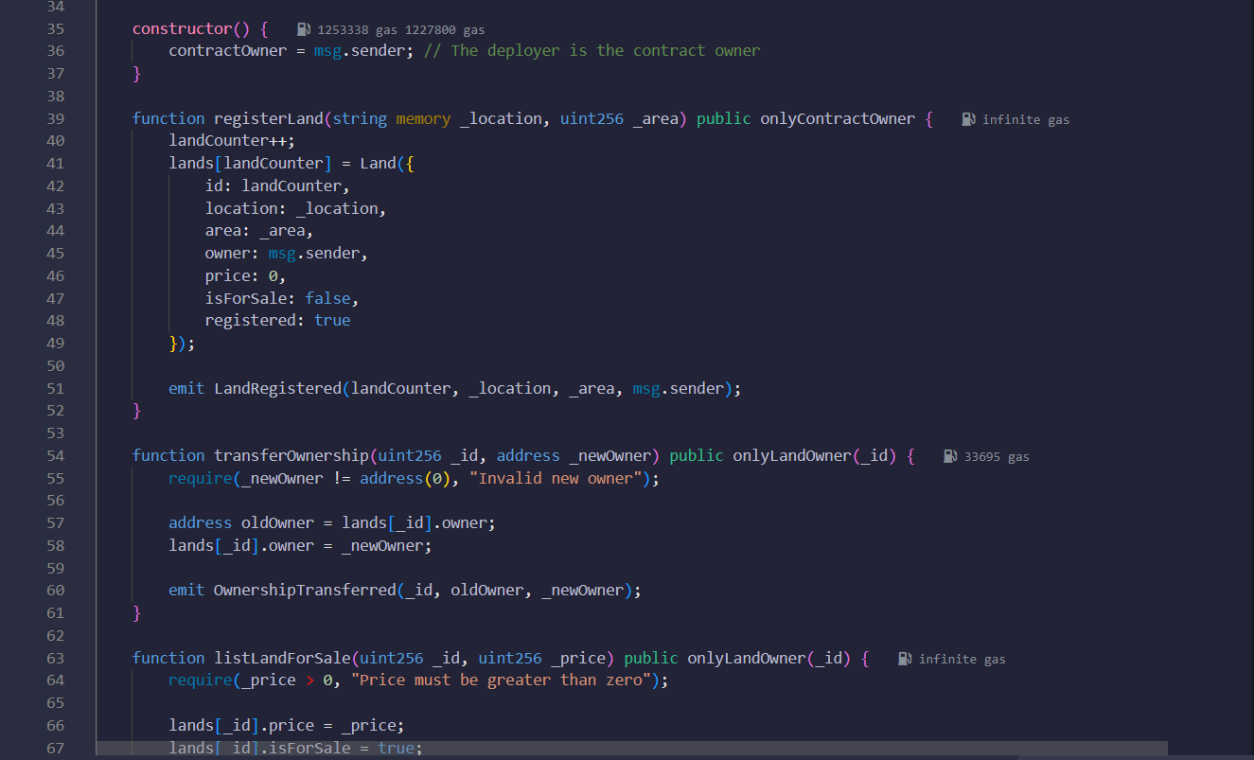
RESULTS
[Add screen shots of your code ]
Demo Link

Slide 8
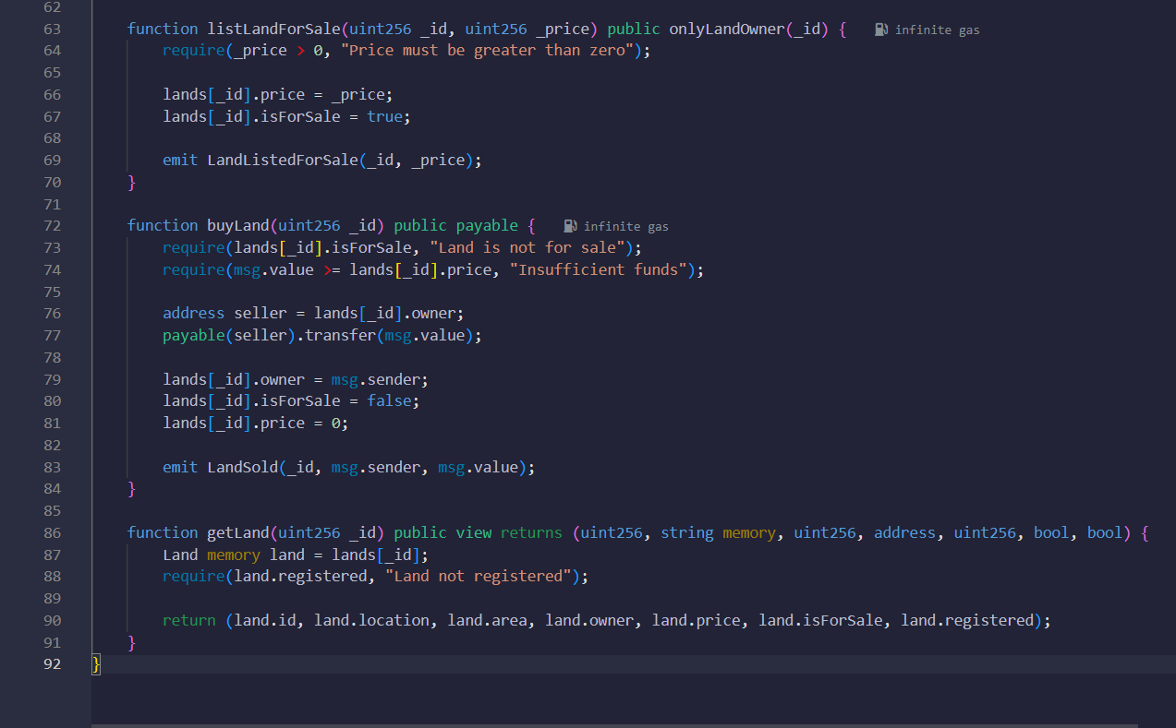
RESULTS
[Add screen shots of your code ]
Demo Link

Slide 9
Conclusion
• Blockchain-based Land Registry ensures secure, transparent, and tamper-proof transactions.
• It eliminates fraud, inefficiencies, and high costs in land ownership.
• A step towards modernizing real estate transactions with blockchain.
.
.

Slide 10
Thank you
Presented by: Aditi Agnihotri
SRMCEM| BTech CSE (Data Science)
GitHub LINK-: aditi549 (Aditi Agnihotri)
.
.

